Slide 1
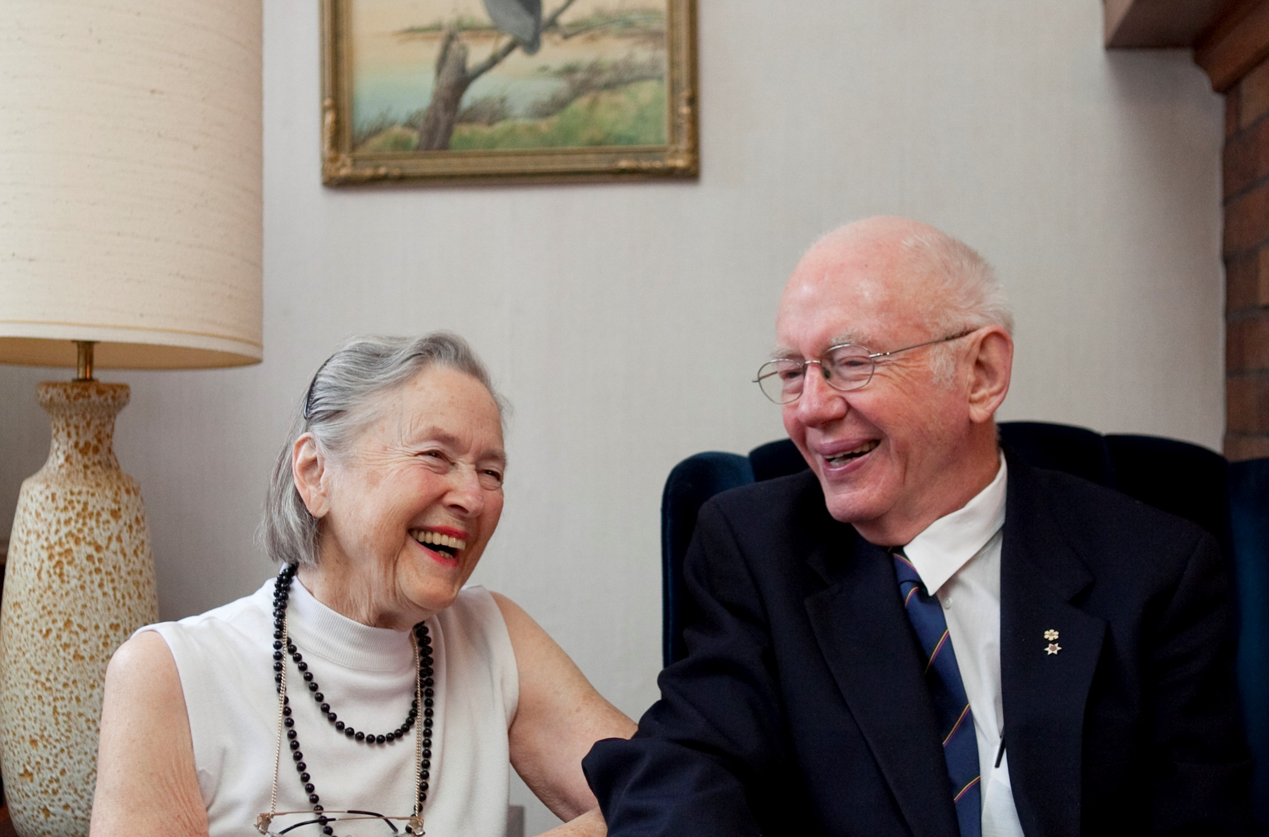
Honouring Life and Legacy
Dr. Stuart Houston and Mary Houston

Slide 2
Stuart Houston and Mary Belcher
Married at St. Lucy’s Church, Dilke, Saskatchewan, August 12, 1951
…Their honeymoon was possibly the only extended period of his adult life when he paid little or no attention to birds.”
- Wendy Roy, “Farmers assist with bird study.” Western People, 1986
UASC, Stuart Houston fonds (MG 164), box 56, file 159

Slide 3
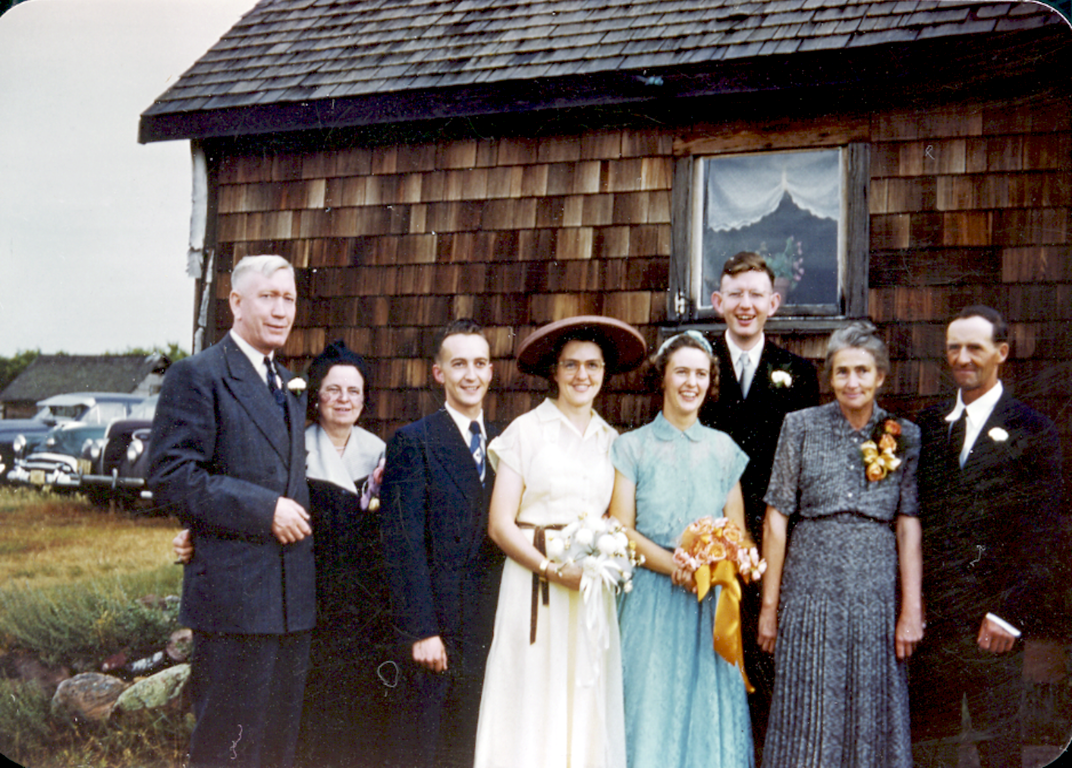
The Houston-Belcher Wedding Party
August 12, 1951
L to R:
Dr. C.J. Houston (Stuart’s father)
Dr. Sigga Houston (Stuart’s mother)
Vernon Barnes (Best man)
Margaret Belcher (Mary’s sister, Maid of Honour)
Mary Houston (bride, née Belcher)
Stuart Houston (groom)
Mary Belcher (Mary’s mother)
Stanley Belcher (Mary’s father)
UASC, Stuart Houston fonds (MG 164), box 56, file 159

Slide 4
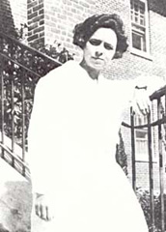
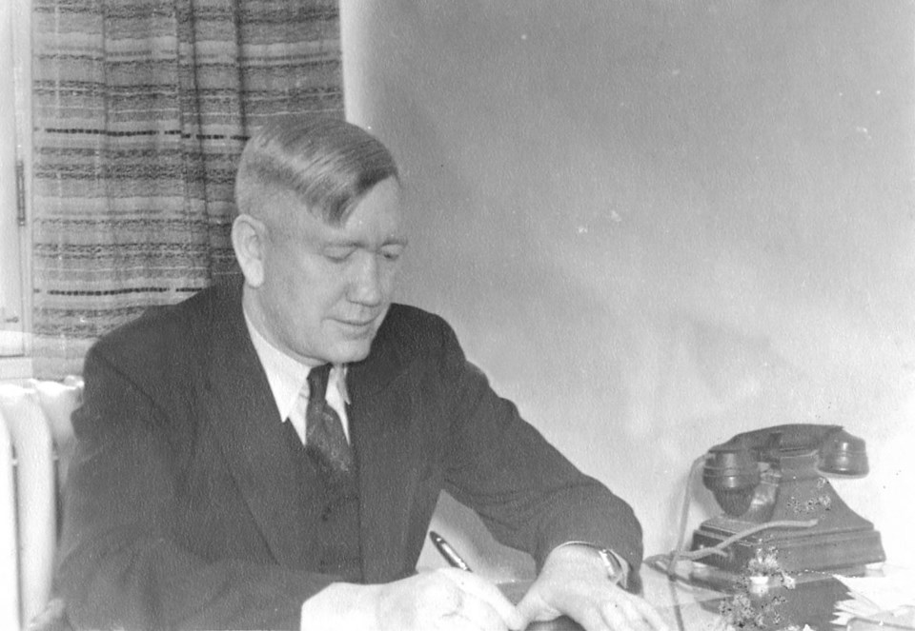
Leading the way in Saskatchewan health
Dr. Sigridur (Sigga) Christianson Houston Pioneering Saskatchewan female physician and Canada’s first female doctor of Icelandic descent.
Dr. Clarence (C.J.) Houston
advocated for a universal provincial health plan in 1943
president of the SK College of Physicians and Surgeons (1947)
president of the Medical Council of Canada
Credit: New Iceland Heritage Museum, NIHM.ca
Credit: Sasktoday.ca, sasktoday.ca/central/opinion/history-corner-stuart-houston-4145464

Slide 5
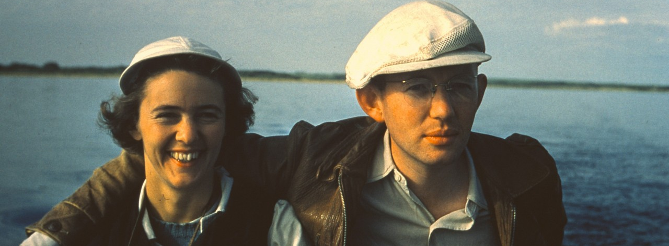
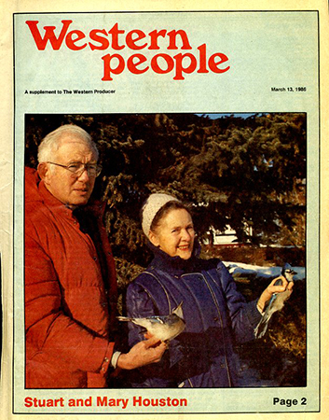
Deep collaboration
Mary and Stuart worked together to advance ornithology, history of Saskatchewan medicine, philanthropy, public policy, and other shared passions.
Stuart and Mary Houston at Redberry Lake. Photo credit: Dr. John Gerrard Sr.,

Slide 6
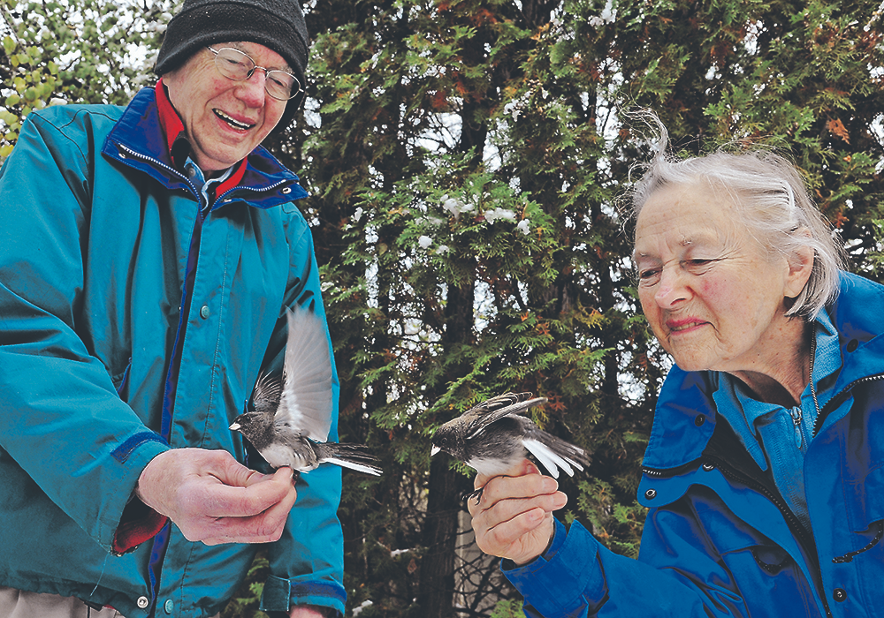
Deep collaboration
About half of the Bohemian Waxwing band recoveries for North America resulted from rings she (Mary) placed on the waxwings.” – Stuart Houston
Credit: William DeKay photo/The Western Producer

Slide 7
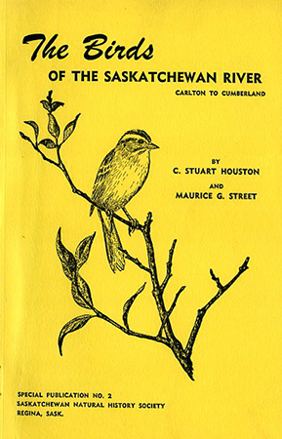
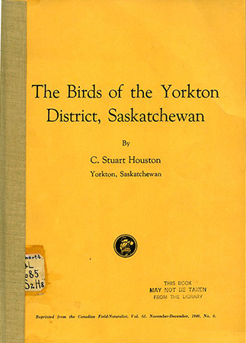
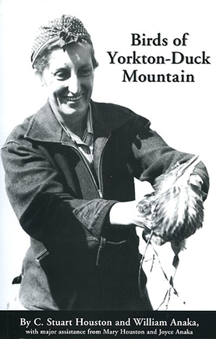
Prolific naturalists
Four books on Saskatchewan natural history.
311 articles in ornithology and natural history journals.
University Archives & Special Collections, University Authors, QL 685.S2H8, QL685 .H84 1959, QL685.5 .S2 H68 2003

Slide 8
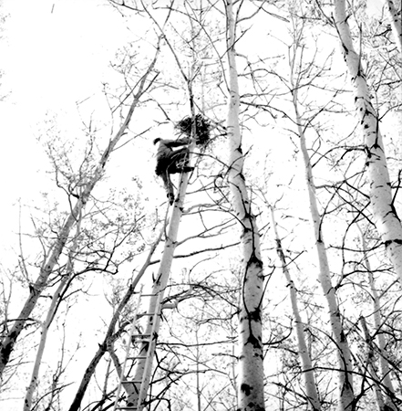
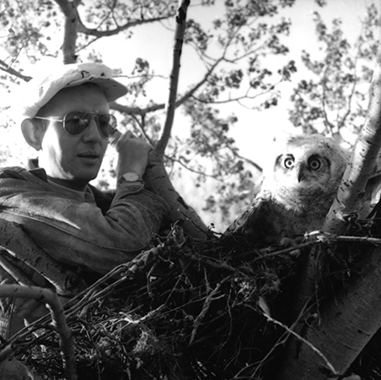
Stuart banding a Great Horned Owl
12 miles west of Saskatoon, May 20, 1966
UASC, MG 172, Hans Dommasch fonds, Box 58, file Dr. Stuart Houston
Photos by Hans Dommasch

Slide 9
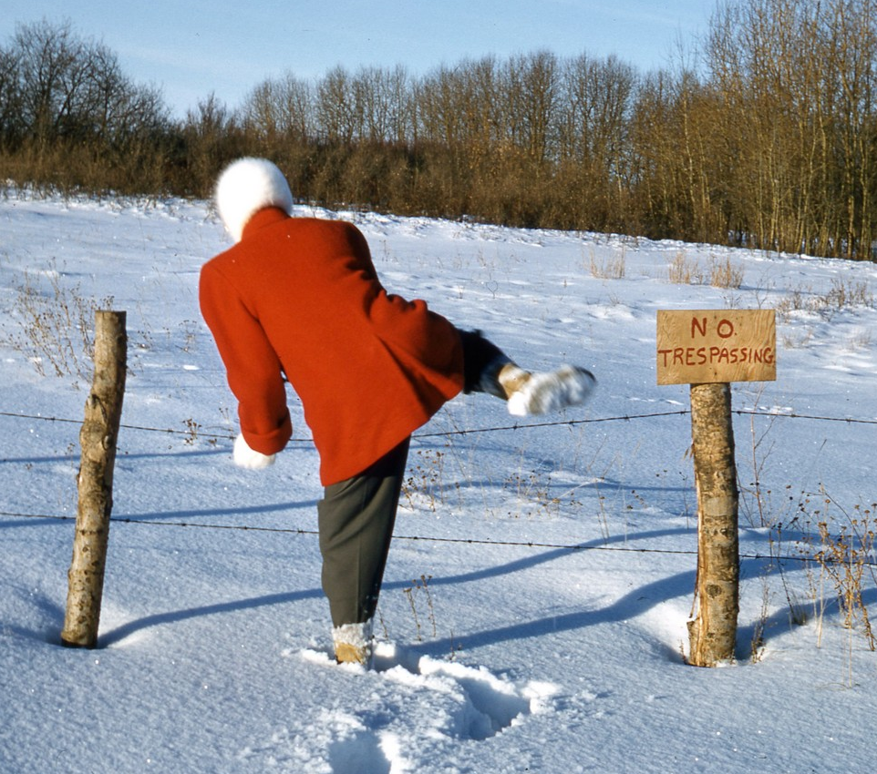
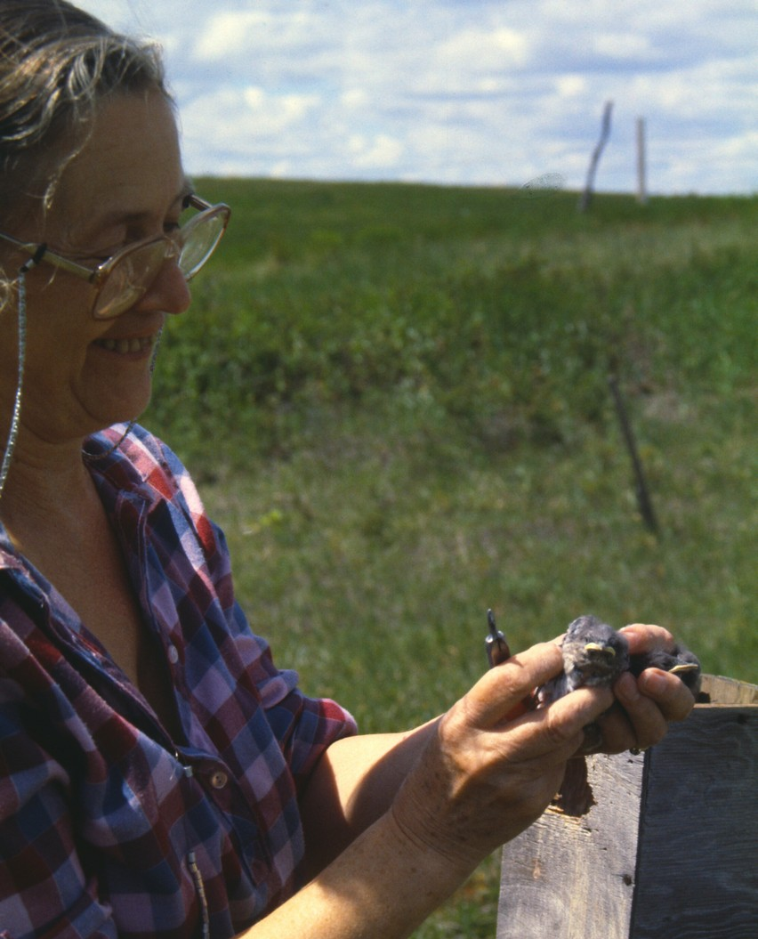
Mary on birding expeditions

Slide 10
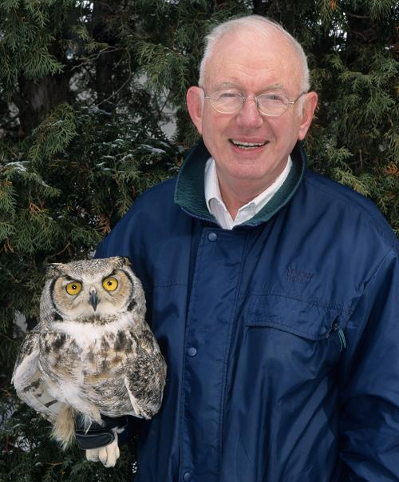
2008 Champion of Owls award
131,267 – total number of birds banded 1943-2007
9,475km – longest distance recovery of a band
20.75 years – age of the longest-living owl banded
Source: Wildbirds Broadcasting http://wildbirdsbroadcasting.blogspot.com/2008/03/canadian-birder-receives-recognition.html

Slide 11
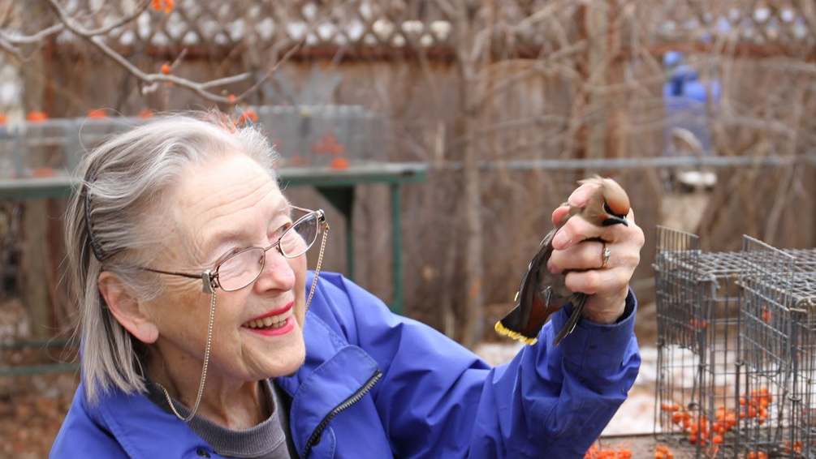
Most bandings of Bohemian Waxwings
in North America (5,387 as of 2016)
Houston, C. Stuart (2016), MARY HOUSTON: NORTH AMERICA’S PRE-EMINENT BOHEMIAN WAXWING BANDER, Blue Jay, 74 (4)
Credit: Brent Terry

Slide 12
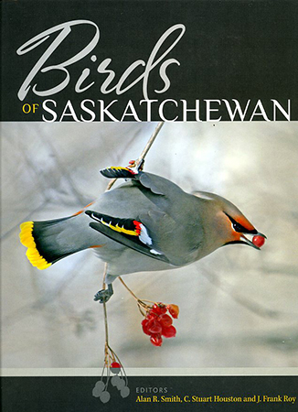
…an accounting of the past 200 years and the current status of 437 bird species, complemented by personal stories and colour photographs
“-- a benchmark for future generations.
University Archives & Special Collections, University Authors, QL685.5 .S2 B58 2019

Slide 13
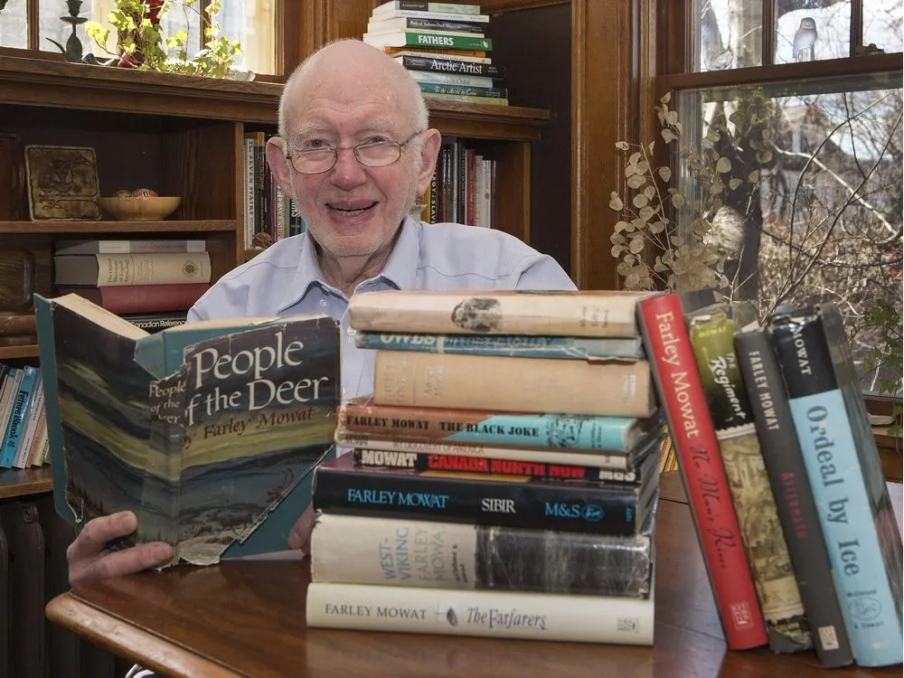
How Farley Mowat Changed My Life: Stuart Houston
Mowat inspired Stuart to do much of his work on birds and to tell the story of the Franklin-expedition explorer and naturalist Dr. Richard Johnson.
Mowat was much the most interesting character I had met—and he kept up irregular contact with me until his death.”
– Stuart Houston
Houston, C. Stuart (2015), HOW FARLEY MOWAT CHANGED MY LIFE, Blue Jay, 73 (4)
Credit: Gord Waldner/ The Saskatoon StarPhoenix

Slide 14
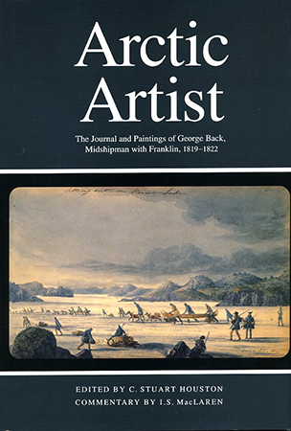
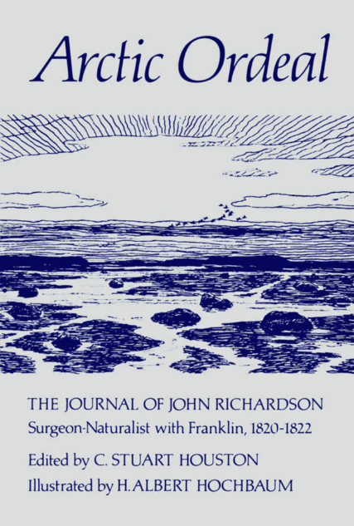
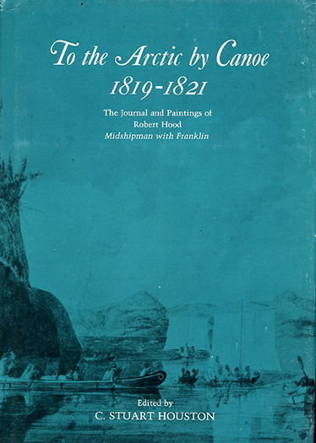
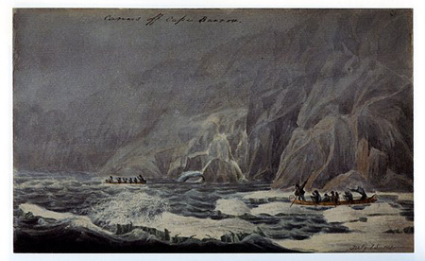
I next achieved what should have been impossible.
I located in turn the unpublished diaries of Franklin’s three officers.
– Stuart Houston

Slide 15
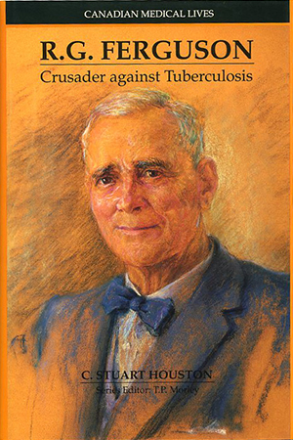
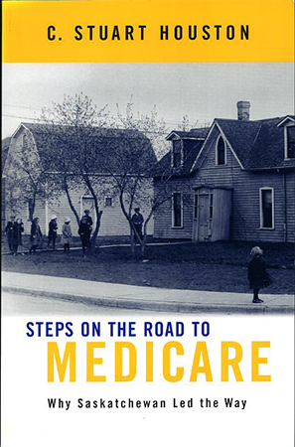
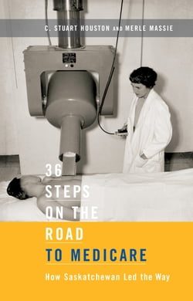
History of medicine in Saskatchewan
Published by the Hannah Institute for the History of Medicine, 1991.
University Archives & Special Collections. University Authors, RA 644.T7H68
Published by McGill-Queen’s University Press, 2001.
University of Saskatchewan Archives & Special Collections, University Authors RA 412.5 .C3H67

Slide 16
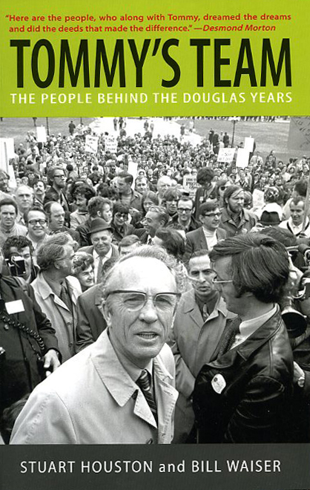
History of medicine in Saskatchewan
“Waiser and Houston recount their stories with insight and style.”
– Allan Blakeney,
former Saskatchewan premier
268 publications by radiologist Dr. Stuart Houston on medicine and the history of medicine
three books,
13 book chapters (incl. three chapters in Pediatric Skeletal Radiology, 1991), and
65 original scientific articles.
University Archives & Special Collections. Shortt Collection, FC 3525.1 .D68 H68.

Slide 17
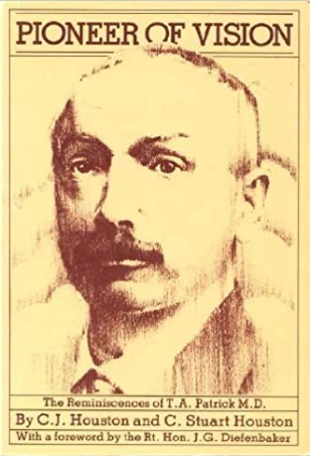
History of medicine in Saskatchewan
Stuart and his father Clarence co-wrote a 1980 biography of Dr. Thomas Patrick, the first physician elected to the SK Legislature and the first politician to propose the current boundaries of Saskatchewan and Alberta.

Slide 18
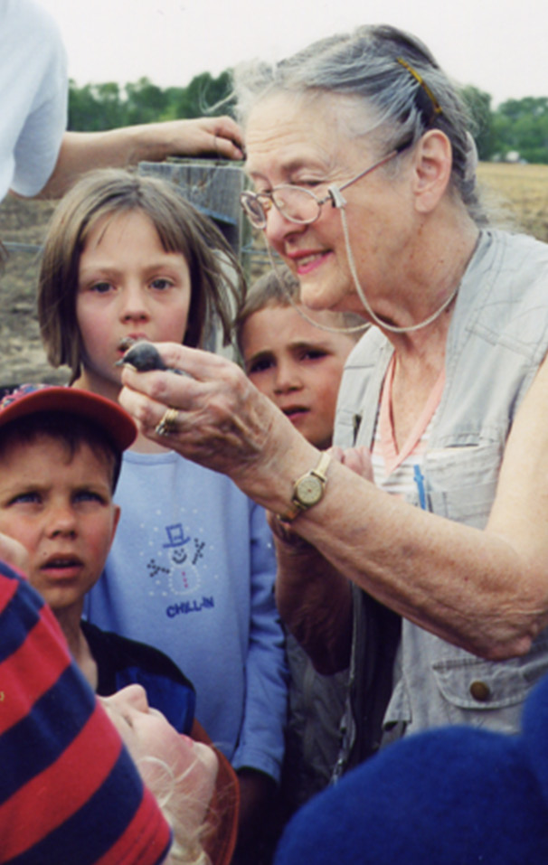
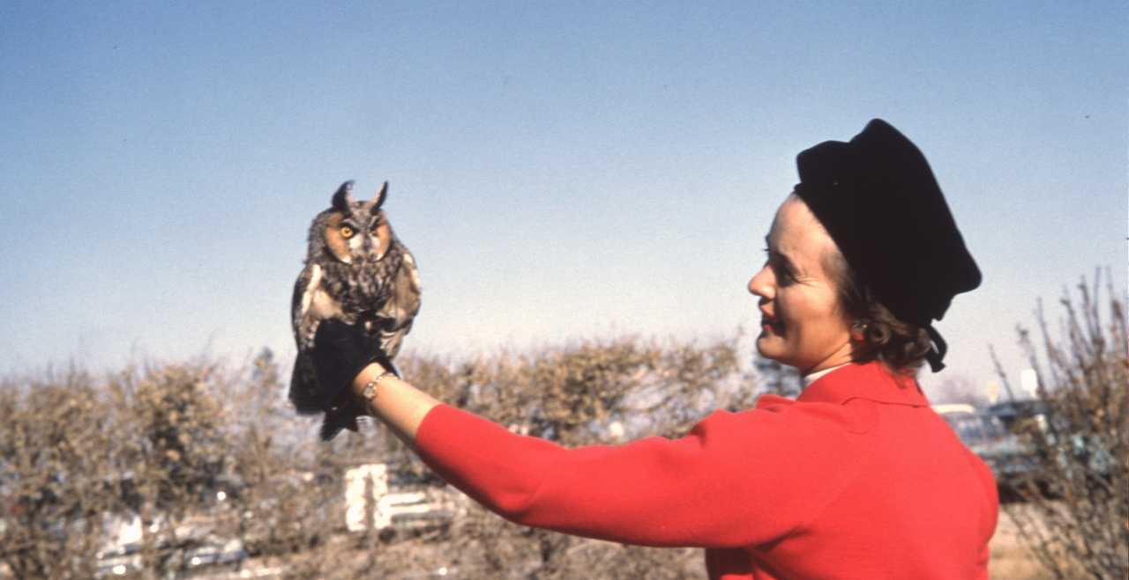
Honours -- Mary Houston
Awarded
Saskatchewan Natural History Society Fellows Award (1987)
Douglas H. Pimlott Conservation Award from the Canadian Nature Federation (1988)
Meewasin Conservation Award (1996)
Nature Saskatchewan’s Conservation Award (2003)
Authored
93 scientific articles,
11 book chapters,
co-authored a book.
Photo credit: Greg Fenty

Slide 19
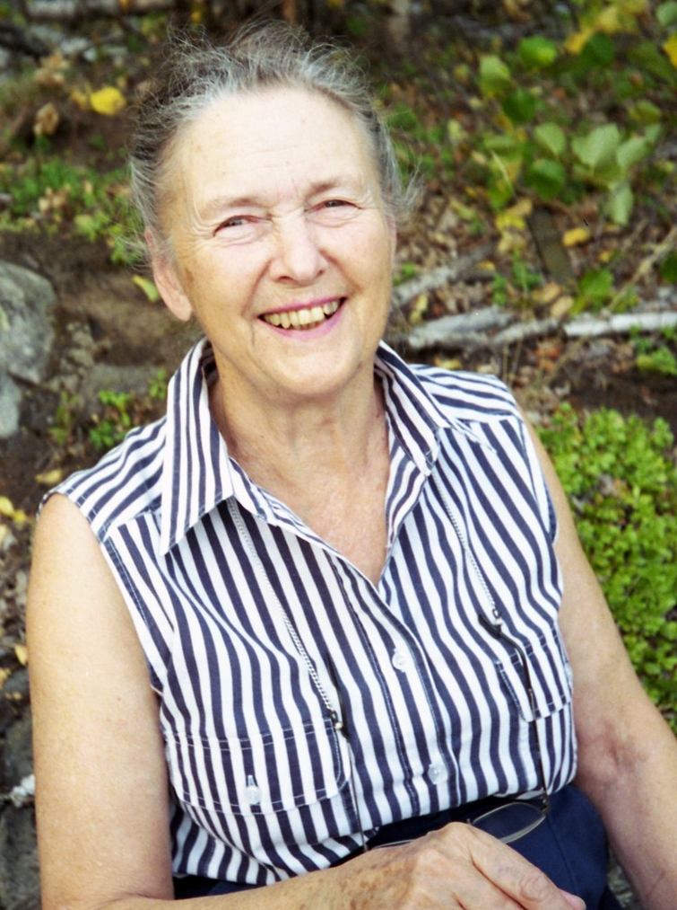
Honours -- Mary Houston (B.A., B.Ed)
Inducted into the Saskatoon Women’s Hall of Fame, 2011
One of Saskatoon’s most remarkable women.
Saskatchewan Volunteer Medal and Saskatchewan Centennial Medal (2005)
USask College of Education Alumni Wall of Honour (2010)
USask College of Arts and Science “Alumnus of Influence Award” (2013)

Slide 20
Recipients of Distinguished Canadian Award, 1992
…recognizes individuals over 55 who have made outstanding contributions to Canadian life
Stuart and Mary Houston
University of Regina
Seniors’ University Group

Slide 21
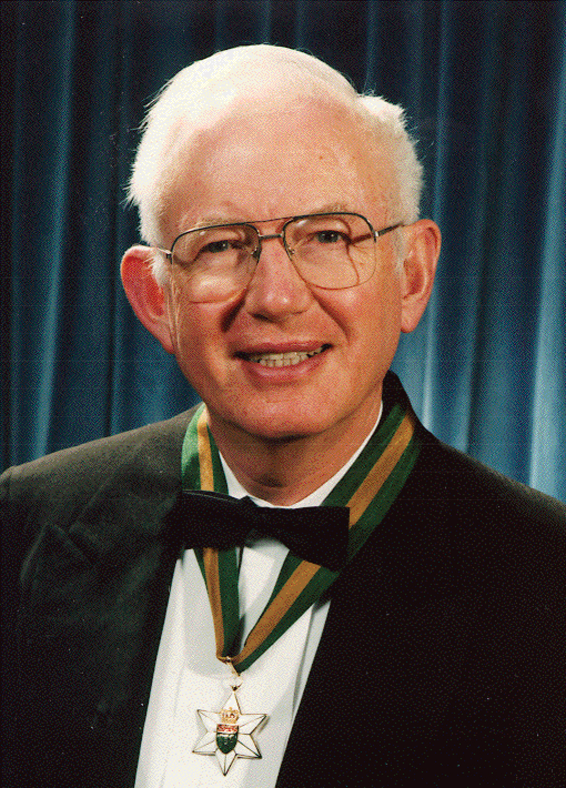
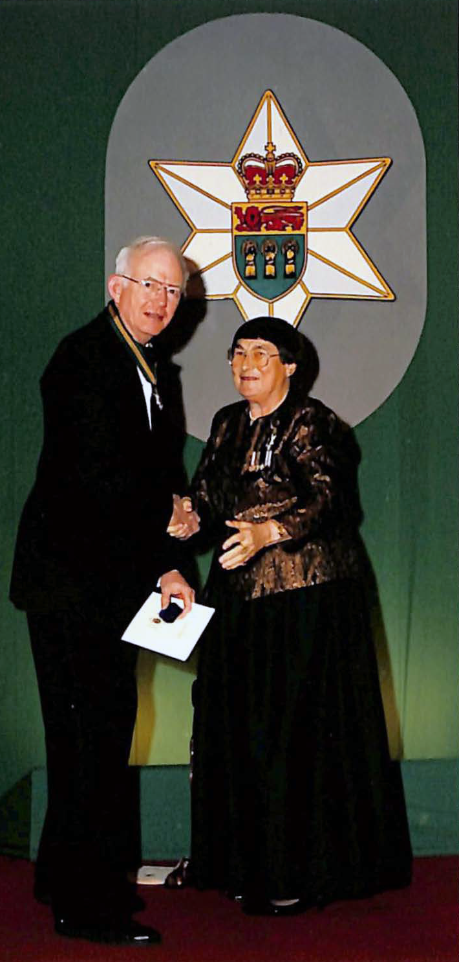
Honours -- Dr. Stuart Houston
Honours
Officer of the Order of Canada (1993)
Saskatchewan Order of Merit (1992)
Gold Medal, Canadian Association of Radiologists (1997)
Eisenmann Medal, Linnaean Society of New York (1990)
Elected Honorary President of the USask Student Medical Society three times (1973-74, 1987-88,1994-95) – the only MD to be so honored

Slide 22
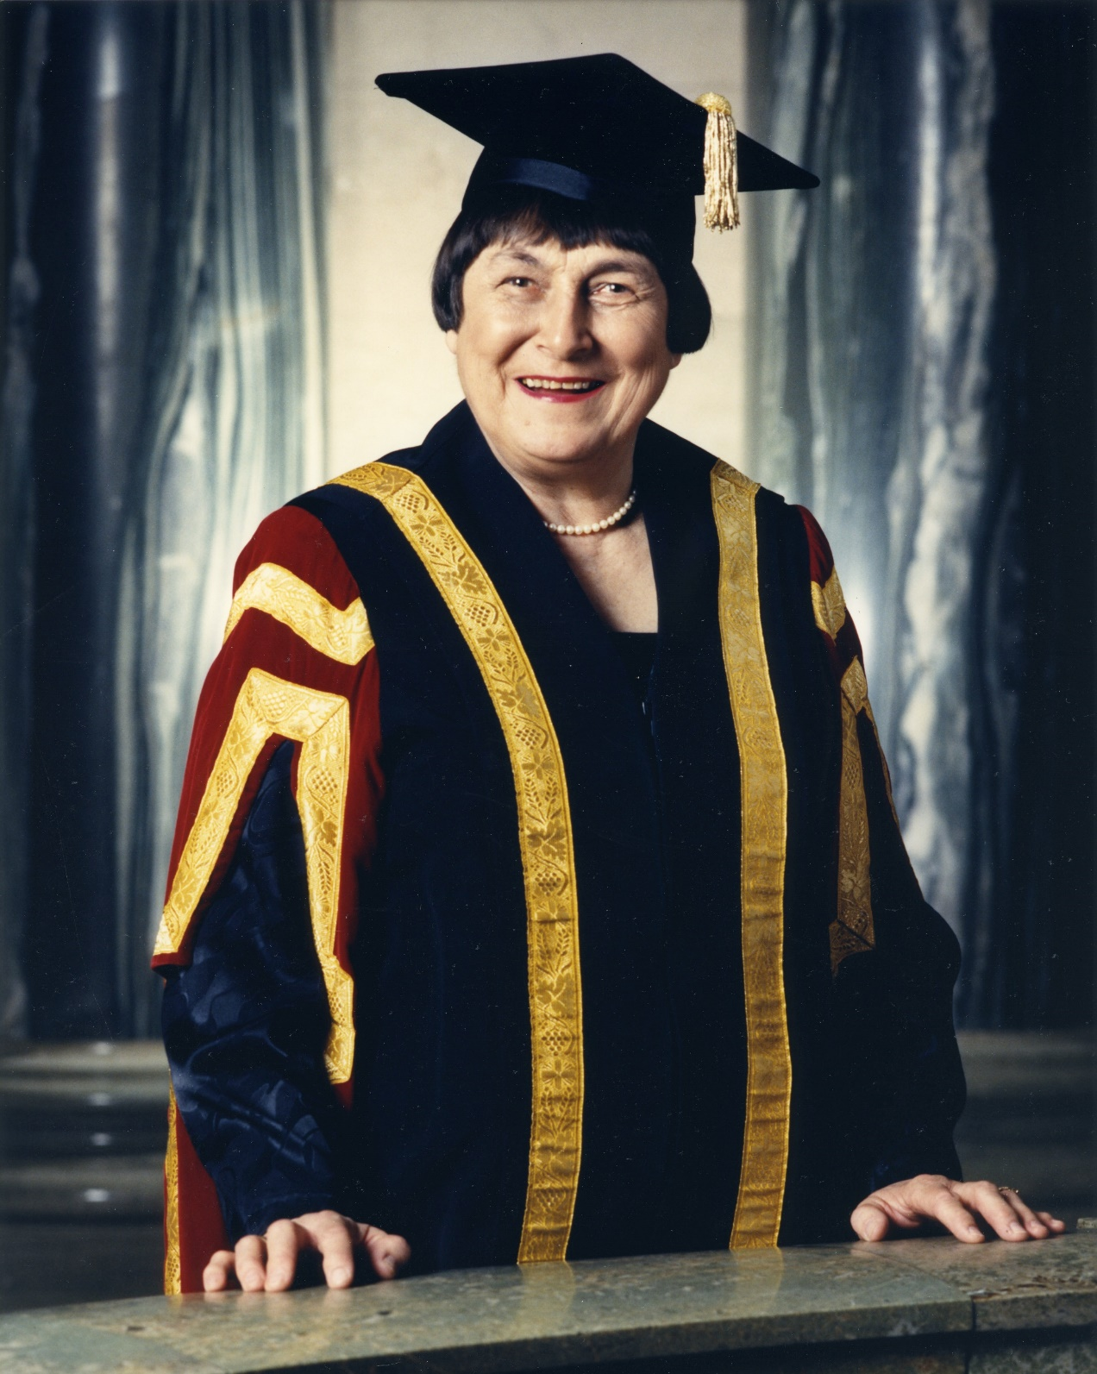
Stuart awarded a USask Earned Doctor of Letters (D.Litt.), 1987
Bestowed by Chancellor Sylvia Fedoruk, a close friend of Stuart ‘s with whom he taught a USask course in radiation physics for nearly 20 years
…the D.Litt. recognizes scholarly and artistic contributions of the highest calibre
UASC, MG 435, Fedoruk Fonds, Box 43, file 1-6.

Slide 23
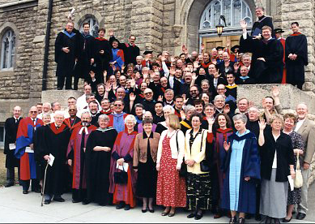
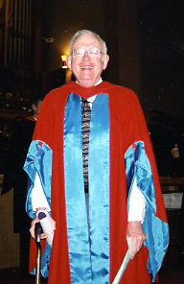
Honorary Doctor of Canon Law
Awarded by USask’s College of Emmanuel and St. Chad,
May 4, 2002

Slide 24
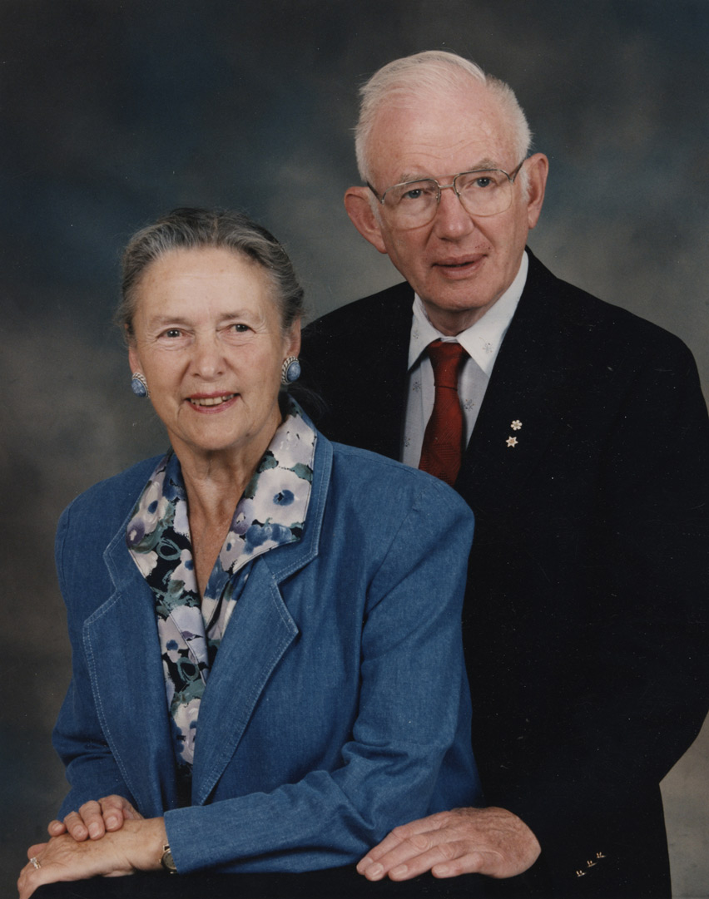
Lives of Giving

Slide 25
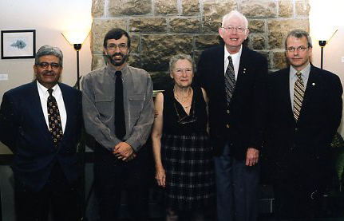
From left: Biology department head Dr. Vipen Sawhney, Dr. Gary Bortolotti, Mary Houston, Dr. Stuart Houston, USask President Peter MacKinnon (November 20, 2002.)
Philanthropy - Stuart and Mary Houston Professorship in Ornithology, est. 2002
First professorship awarded to
Dr. Gary Bortolotti
Awarded to a prominent and active participant in research and both undergraduate and graduate teaching
University Archives & Special Collections, CJ Houston fonds, MG 164, Box 58, file 195.

Slide 26
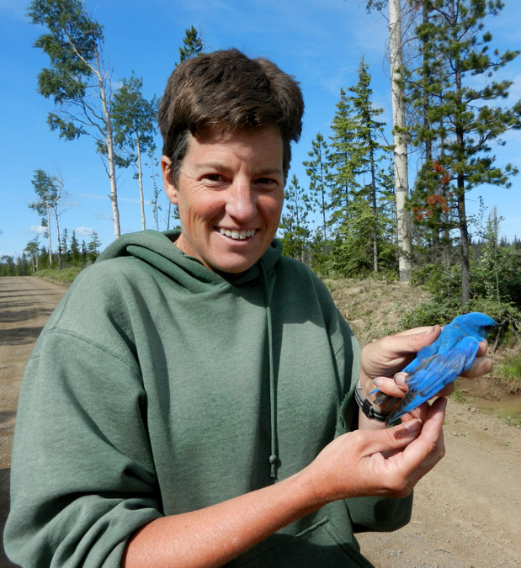
Philanthropy - Stuart and Mary Houston Professorship in Ornithology, est. 2002
Second professorship awarded to
Dr. Karen Wiebe, USask biology researcher

Slide 27
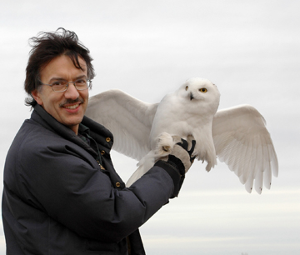
recognizes outstanding academic achievement of undergraduate students in the area of ornithology.”
Stuart Houston Book Prize in Ornithology
Awarded annually to the student with the highest mark in Biology 458.3.
Established in 1998 by Prof. Gary Bortolotti to honour Dr. Stuart Houston.

Slide 28
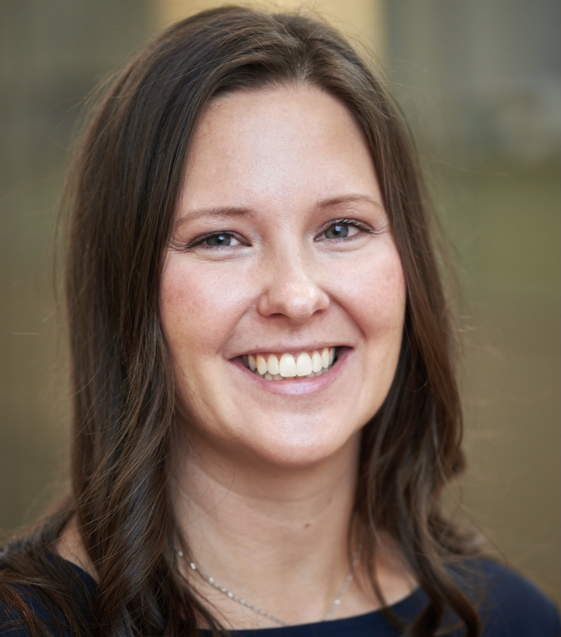
Established by the College of Medicine medical imaging department to honour Stuart Houston.
Stuart Houston Award for Medical Imaging Research
Dr. Leanne Langford
2019 Recipient

Slide 29
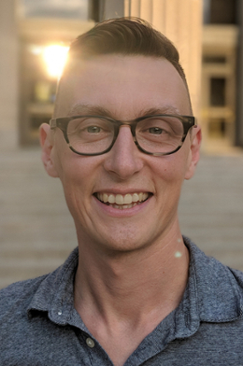
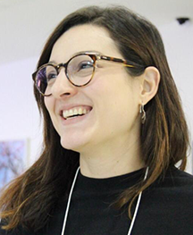
Philanthropy
Philanthropy - The Houston Family Trust for Evidence-Based Public Policy
Created to support research directed at generating and assembling evidence to inform public policy development
. . . initiatives include The Houston Lecture, hiring post-doctoral fellows, and recruiting faculty
Dr. Charles (Chuk) Plante
Dr. Vince Hopkins
Dr. Catarina Segatto
Post-doctoral Fellow
Assistant Professor
Post-doctoral Fellow

Slide 30
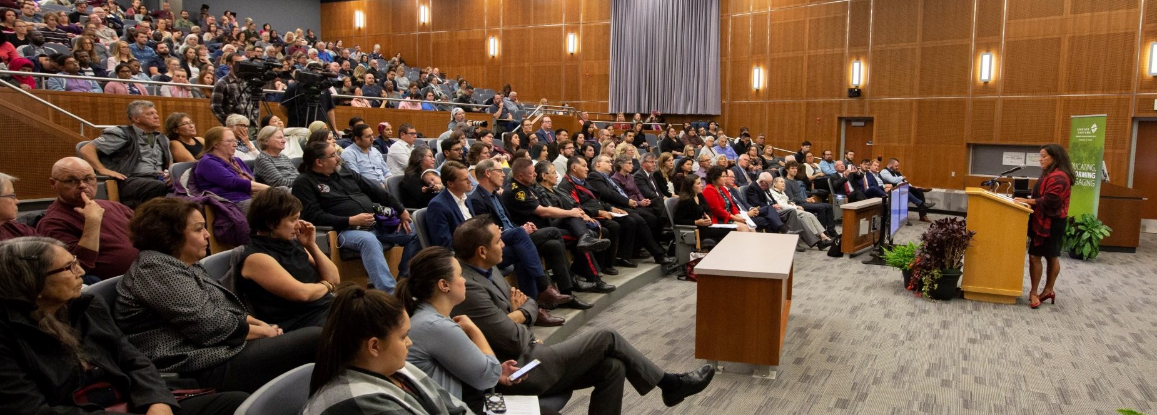
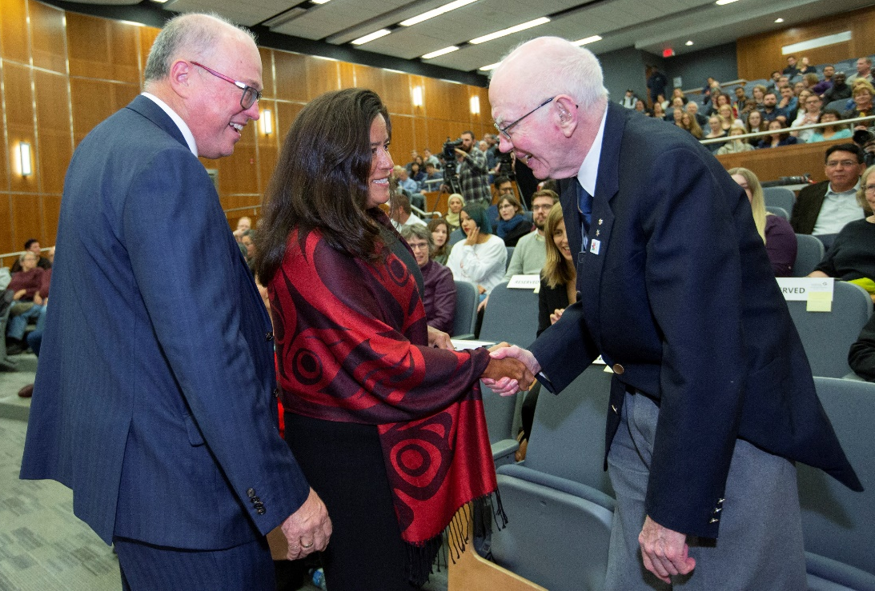
Philanthropy
Philanthropy - The Houston Lecture, Johnson Shoyama Graduate School of Public Policy
Brings together leading experts on current issues related to inequality, health, and social policy in Canada.
Inaugural Lecture, Sept. 2018
—
The Honourable Jody Wilson-Raybould, then Minister of Justice and Attorney General of Canada

Slide 31
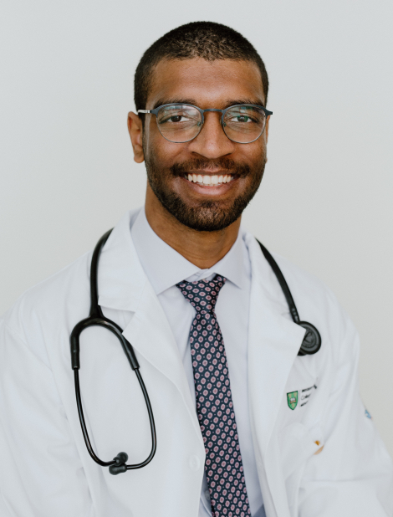
Awarded annually to a first-year medical student who submits the best essay on the history of medicine … created by Dr. Clarence Houston in 1989 and supported by Dr. Stuart and Mary Houston
Philanthropy C.J. Houston Prize in Medical History, College of Medicine
Mujtaba Ibrahim
2021 Recipient
Photo credit: saskmedstudents.com

Slide 32
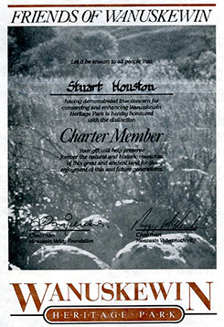
Philanthropy
Contributed to:
Blaine and Pat Holmlund Scholarship for First Nations People
USask Library Archives, Annual Campaign, and other support
Sigga Christianson Houston Travel Award (UManitoba)
Friends of Wanuskewin
Houston was a donor and charter member…[whose] gift will help preserve forever the natural and historic resources of this great and ancient land for the enjoyment of this and future generations.”
– Wanuskewin Heritage Park

Slide 33
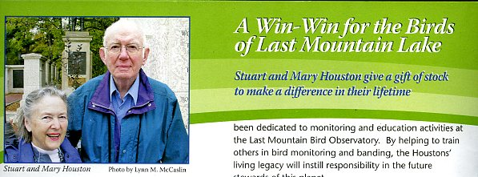
Philanthropy
Donation of stock to
Last Mountain Lake National Wildlife Area
Canada’s first protected wildlife area
First federal bird sanctuary preserved in North America
“The couple honoured their deep love of nature … [through a gift] dedicated to monitoring and education activities.
University Archives & Special Collections, CJ Houston fonds, MG 164, box 58, file 196.

Slide 34
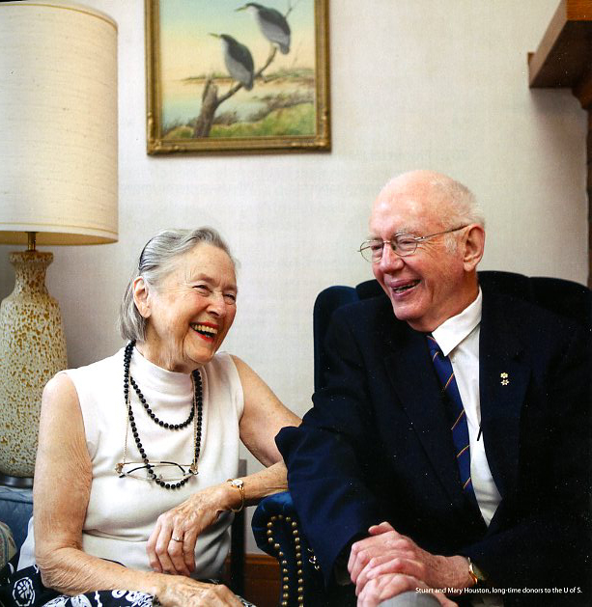
Philanthropy
Recipients of the
Honoured Supporter Award
Association of Fundraising Professionals (AFP) Saskatoon Chapter National Philanthropy Day, 2010
Nominated by the University of Saskatchewan

Slide 35
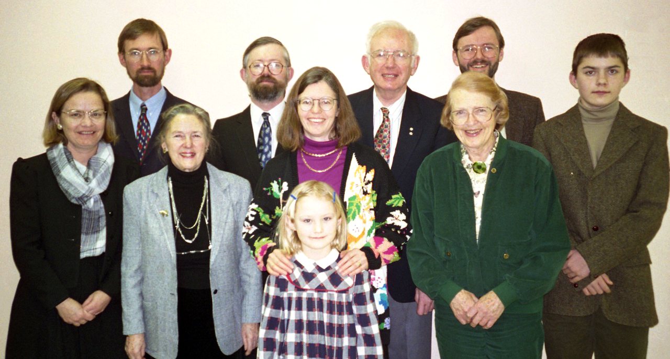

Slide 36
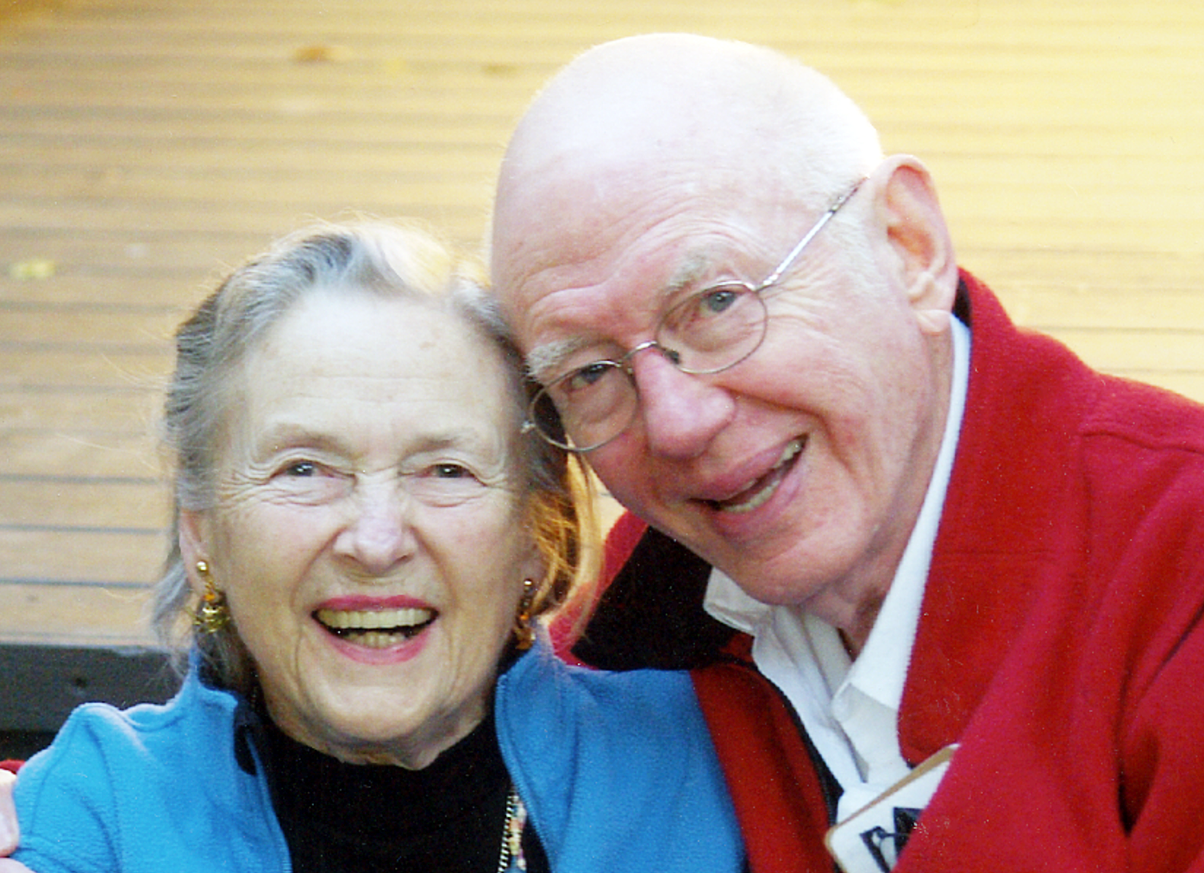
Stuart and Mary Houston, 60th Wedding Anniversary, 2011.
Photographer: Cathy Knowles.
University Archives & Special Collections, MG 164, CS Houston fonds, box 56, file 160.

